Slide 1
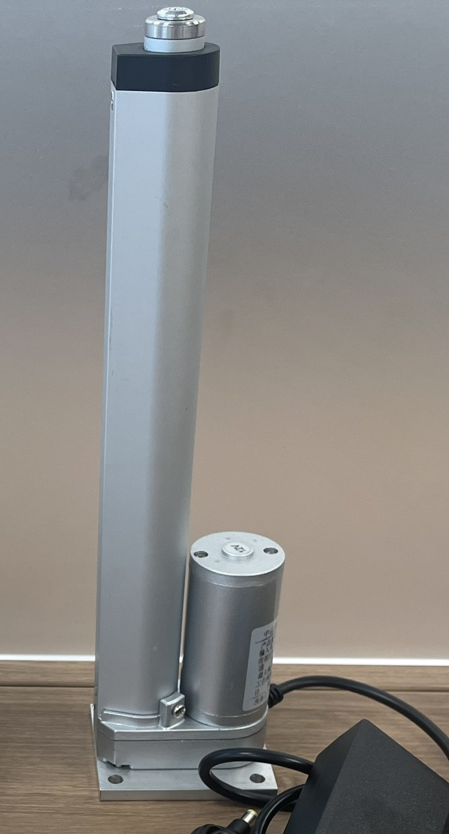
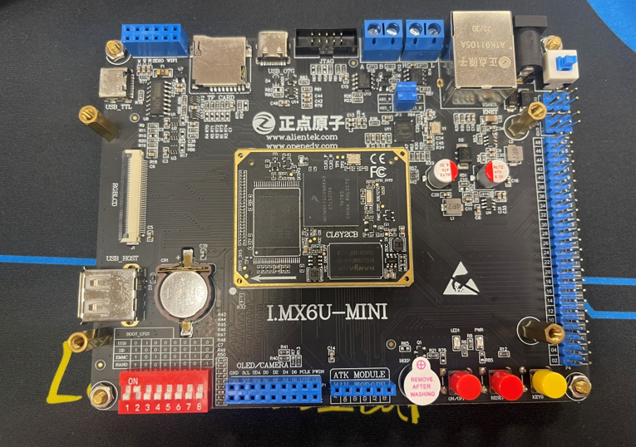
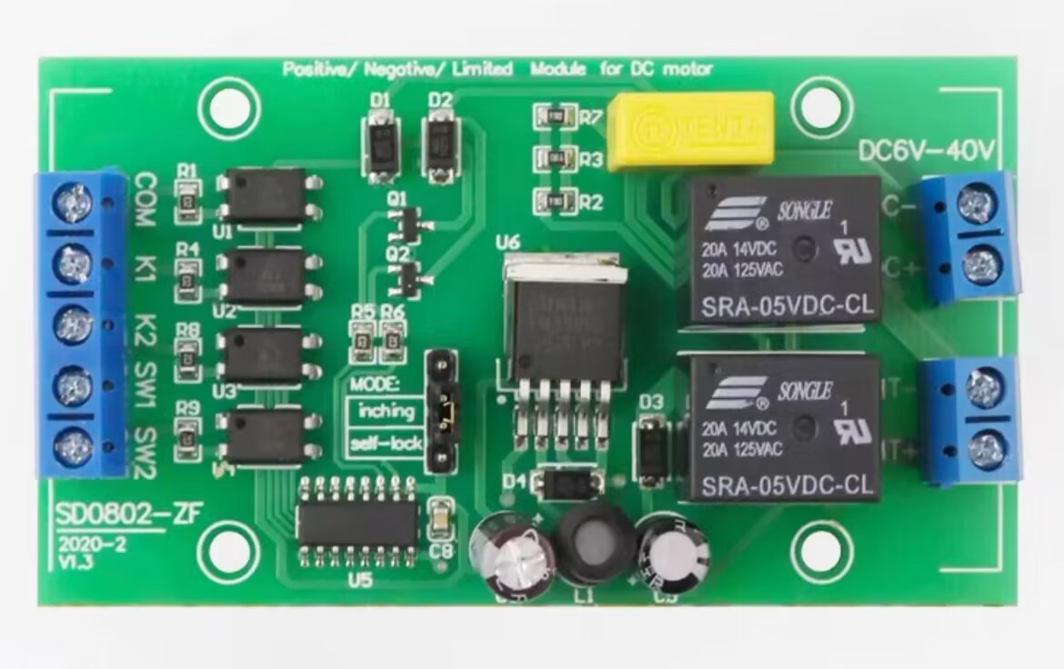
Cavity
Piston jack buoyant device control
Through imx6 control DC motor
controller k1k2 control jack
positive and negative rotation

Slide 2
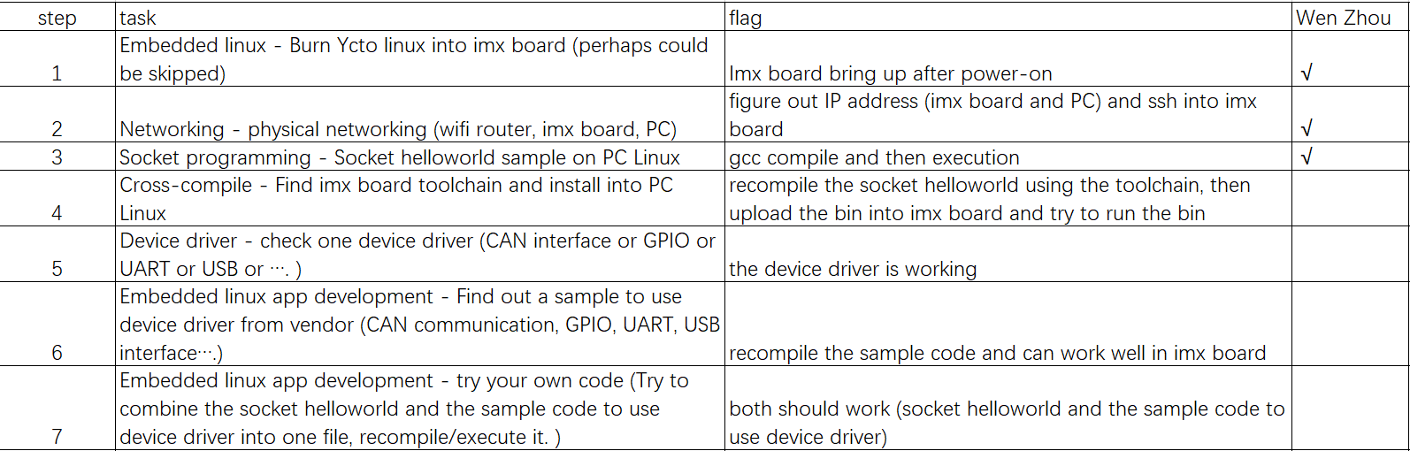
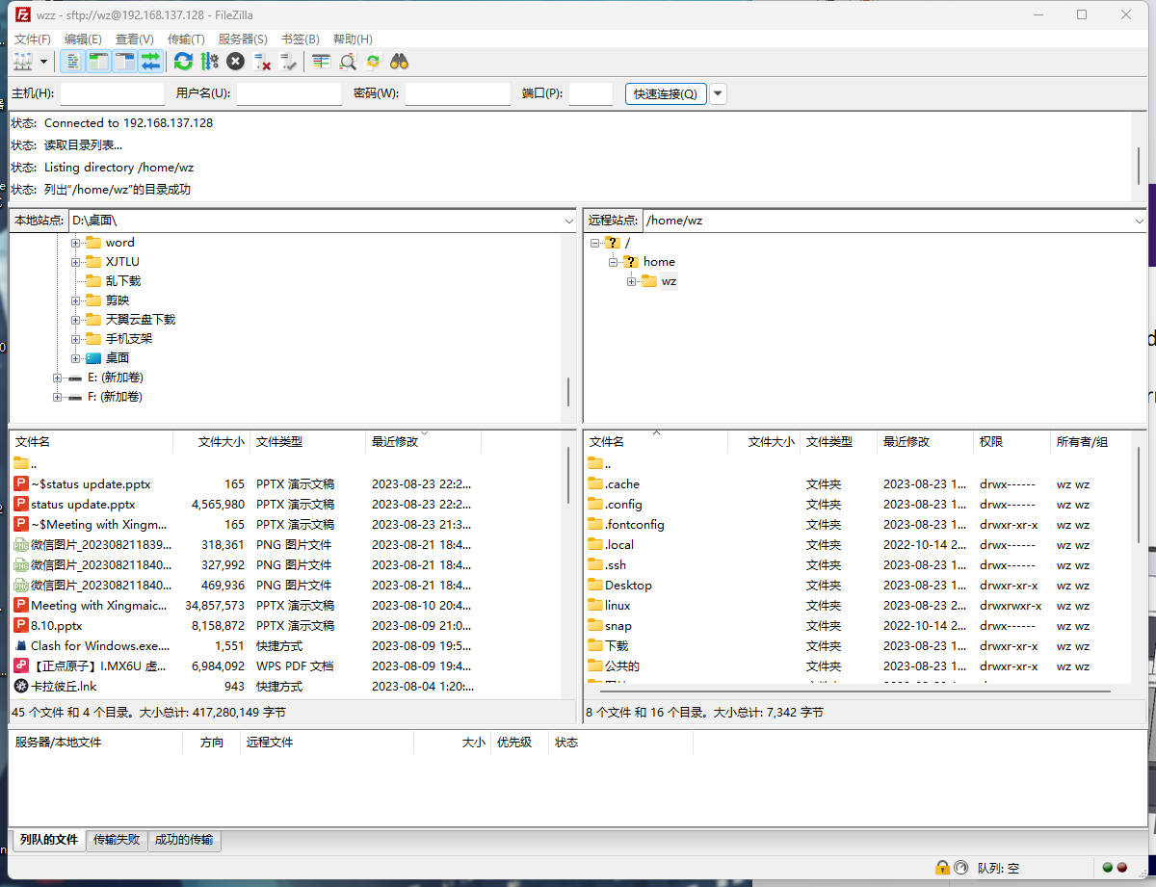
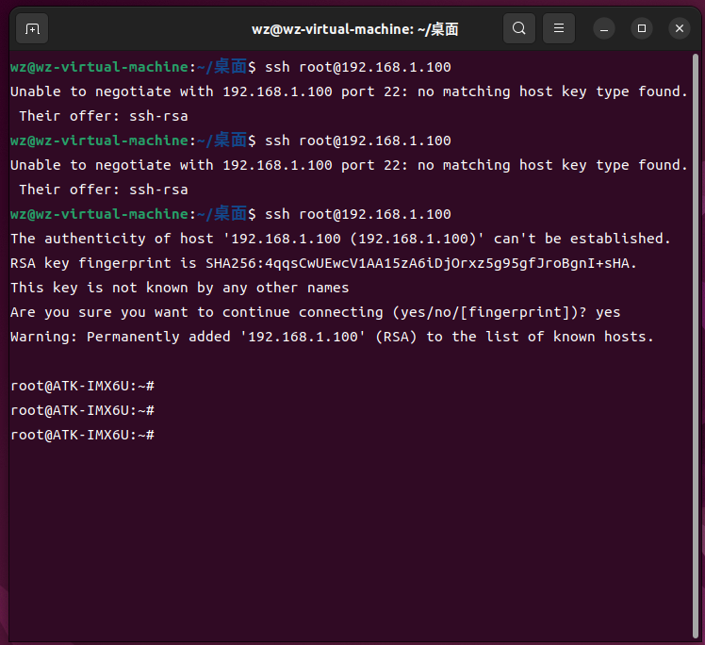
Cavity
Setup the development env (burn ycto linux into the board and ssh into the board)

Slide 3
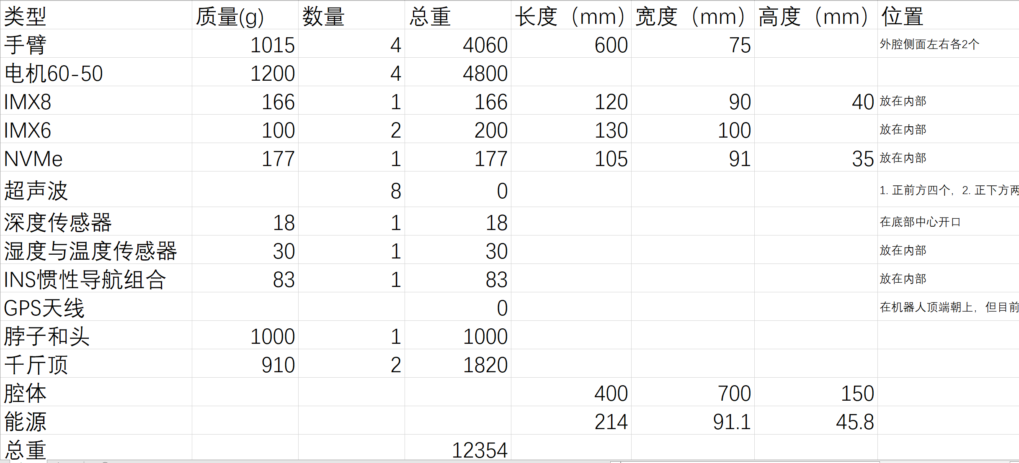
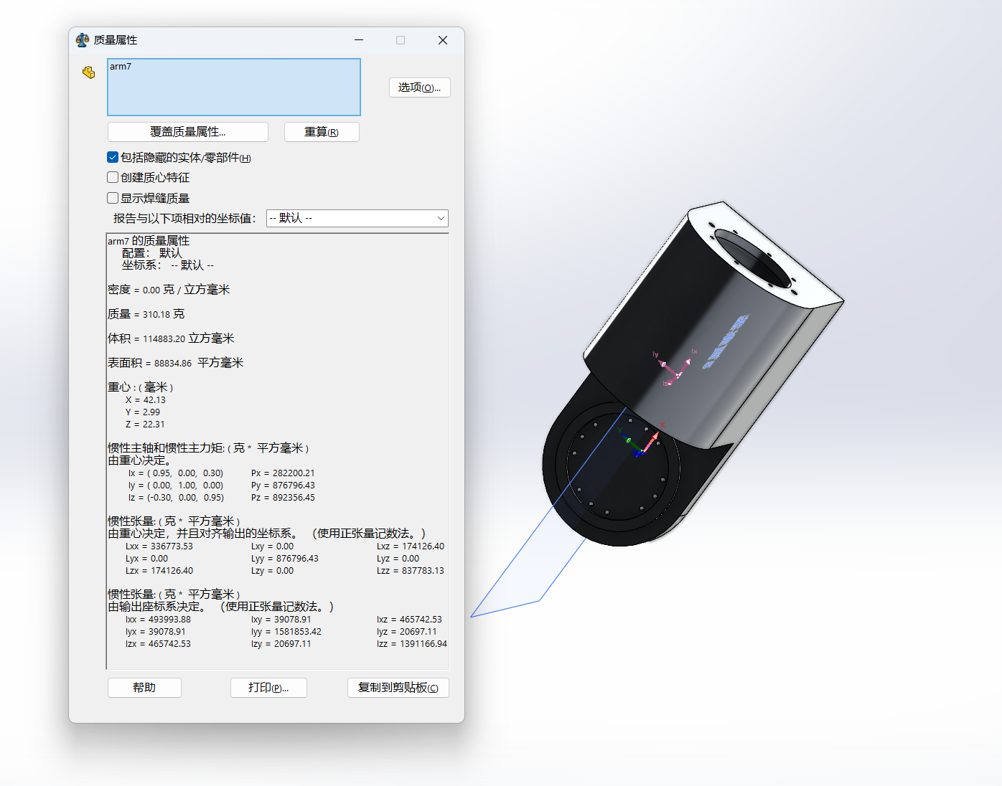
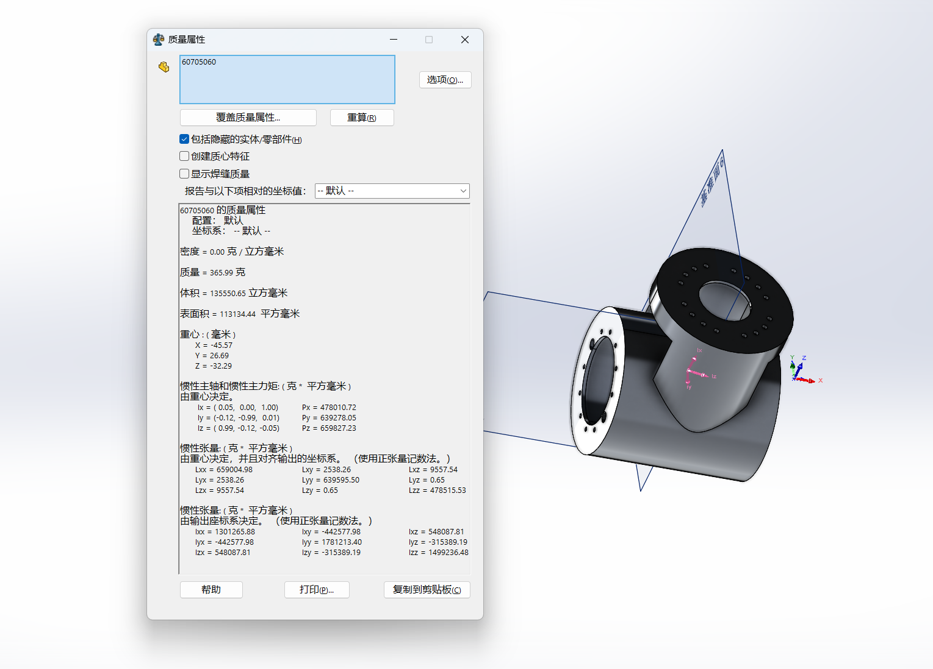
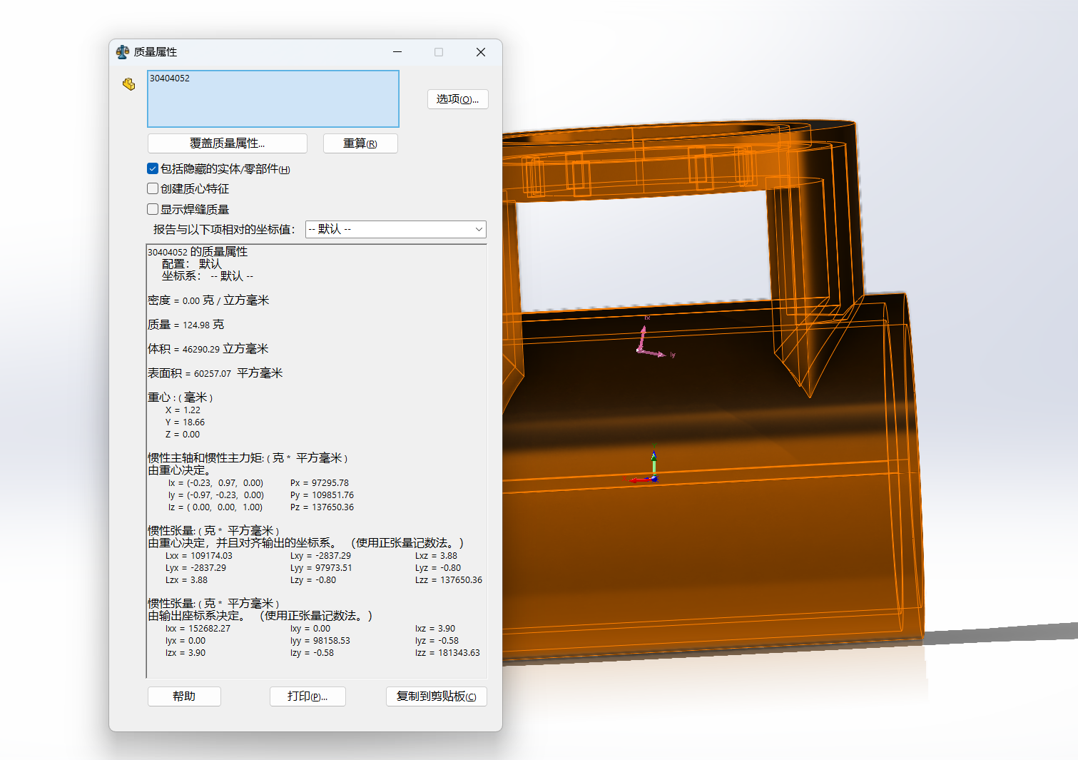
Cavity
All Turtle Parameters

Slide 4
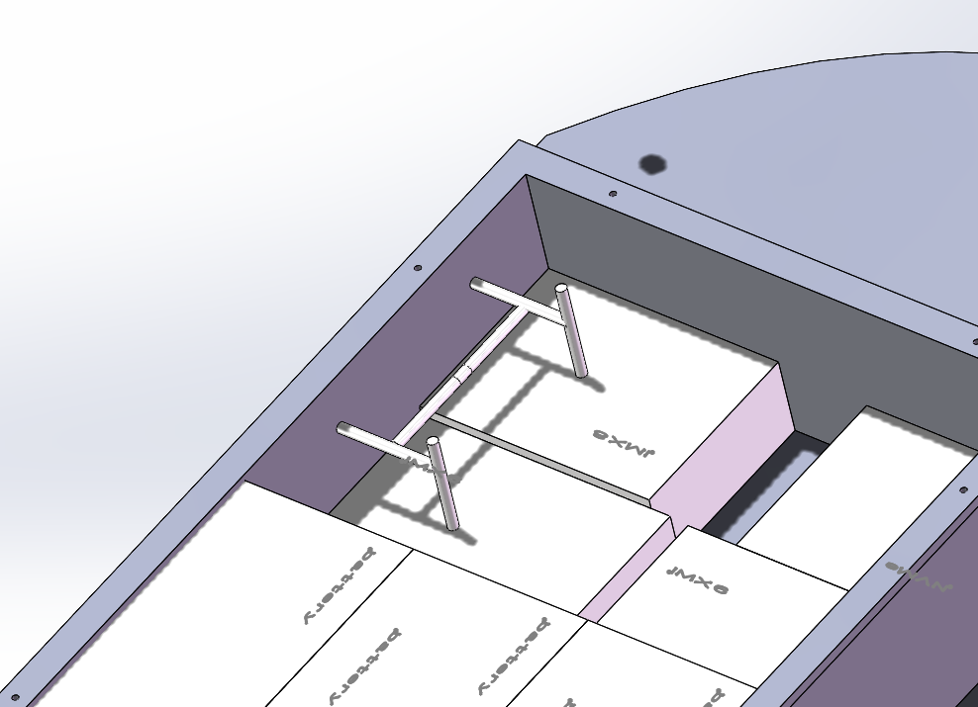
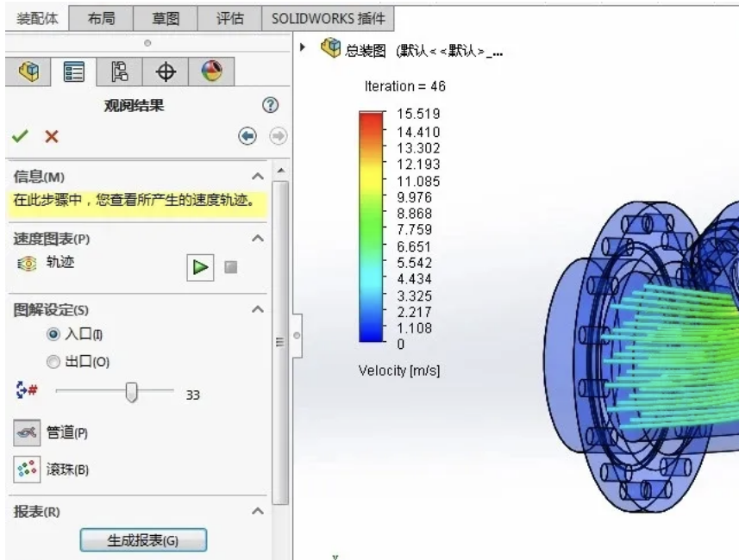
Cavity
Cavity fixation and mechanical streamlining analysis
Use fixtures to hold
the chip and battery
in the inner cavity
Testing Water Friction
with SolidWorks Flow
Simulation

